Slide 1
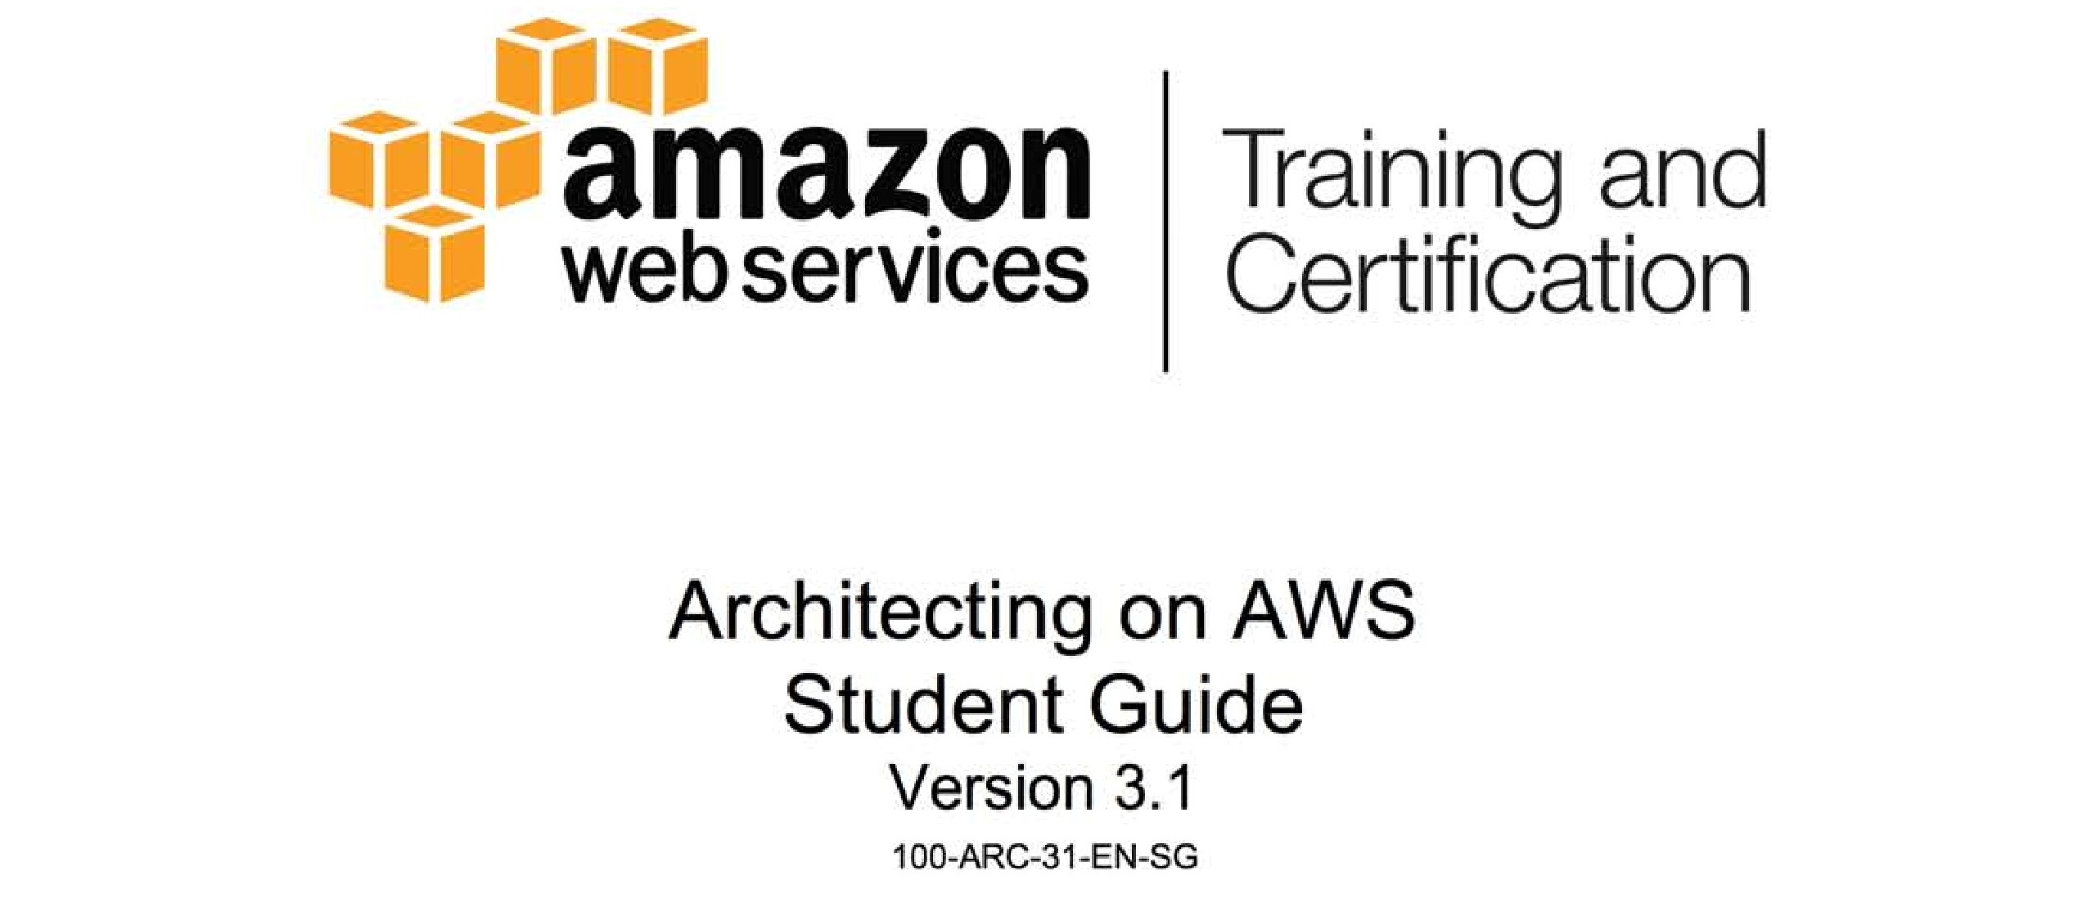
Notes:
1

Slide 2

Module 2: Architecting in the Cloud
Notes:
2

Slide 3
Topics
Five benefits of the cloud
Seven best practices for building systems with AWS
Notes:
3

Slide 4
Topics
Five benefits of the cloud
Seven best practices for building systems with AWS
Notes:
4

Slide 5
What makes the cloud attractive?
Abstract Resources
Focus on your needs, not hardware specs. As needs change, so should your resources
On-Demand Provisioning
Ask for what you need, exactly when you need it; get rid of it when you do not
Scalability in Minutes
Scale out or in, up or down, depending on usage or needs
Notes:
5

Slide 6
What makes the cloud attractive? (continue)
Pay Per Consumption
No long-term commitments. Pay only for what you use
Efficiency of Experts
Utilize the skills, knowledge and resources of experts
Notes:
6

Slide 7
Topics
Five benefits of the cloud
Seven best practices for building systems with AWS
Notes:
7

Slide 8
Seven best practices for building system with AWS
Design for failure and nothing fails
Loose coupling sets you free
Implement elasticity
Build security in every layer
Don’t fear constraints
Think parallel
Leverage different storage options

Slide 9
Seven best practices for building system with AWS
“Everything fails, all the time”
Werner Vogels, CTO, Amazon.com

Slide 10
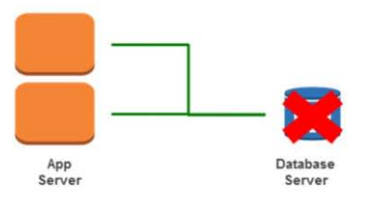
Seven best practices: Design for failure
Avoid single points of failure
Assume everything fails and design backwards
Goal: Applications should continue to function even if the underlying physical hardware fails or is removed/replaced.

Slide 11
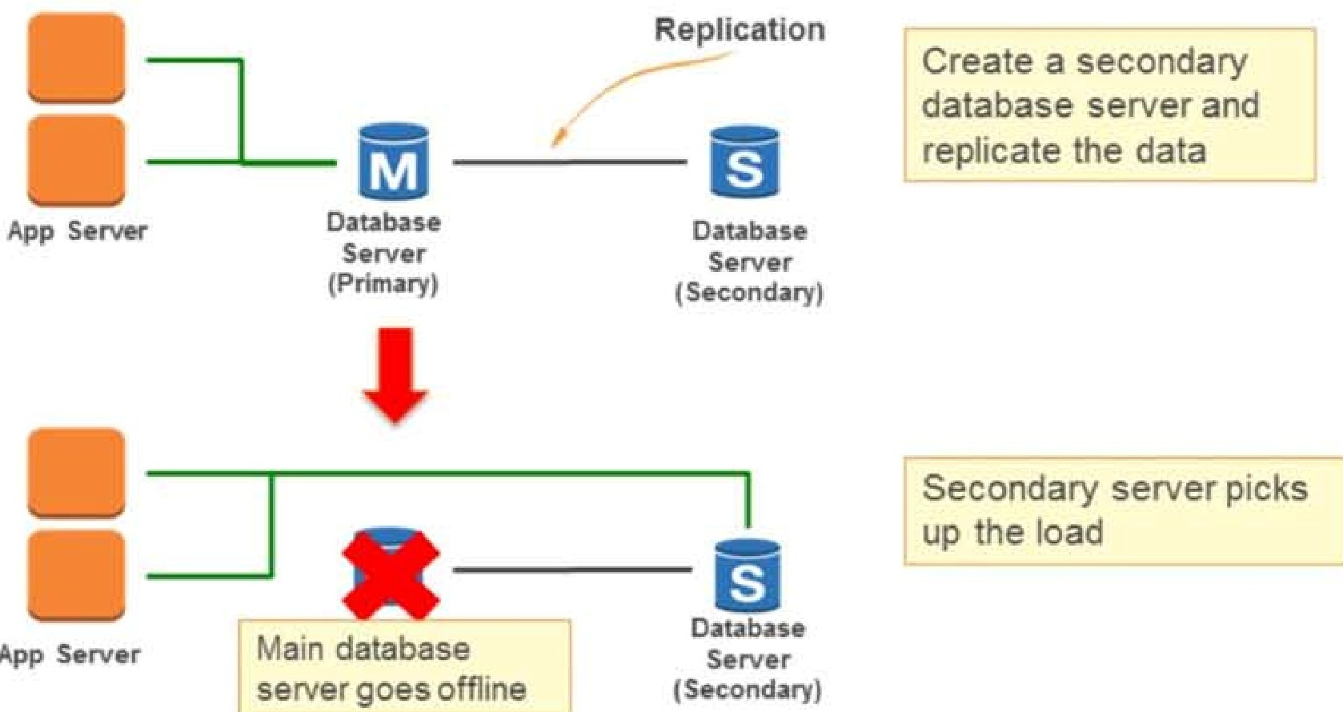
Seven best practices: Design for failure (continue)
Notes:
11

Slide 12
Seven best practices: Loose coupling
Design architectures with independent components
The more loosely they are coupled, the bigger they scale
Design every component as a black box
Load balance clusters
Use a queue to pass messages between components
Notes:
12

Slide 13
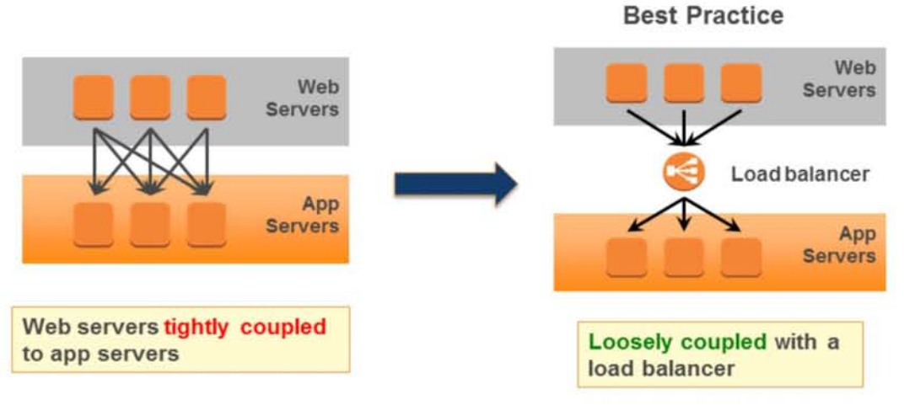
Loose coupling: Load balance the cluster
Notes:
13

Slide 14
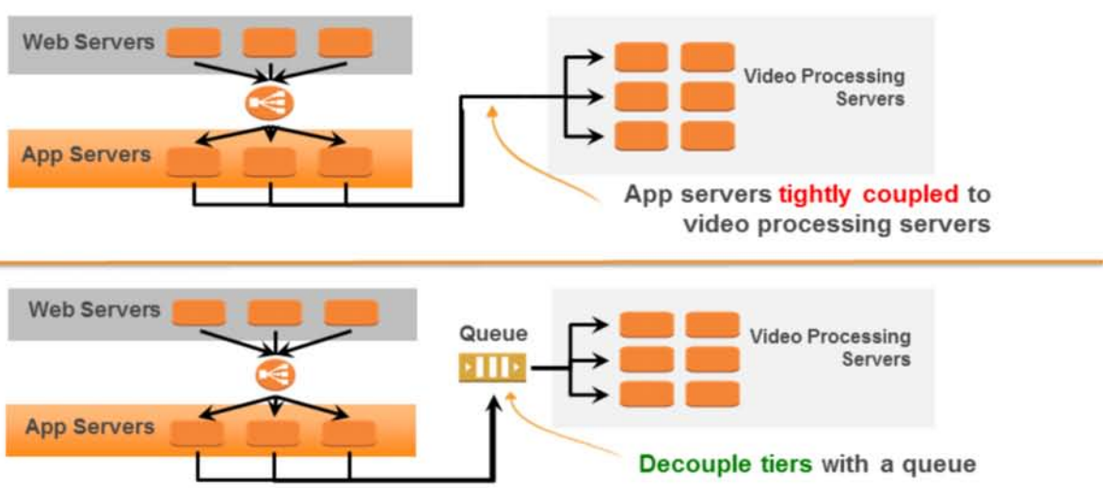
Loose couping: Use a queue to pass messages

Slide 15
Seven best practices: Implement elasticity
Elasticity is a fundamental property of the cloud
Do not assume the health, availability, or fixed location of components
Use designs that are resilient to reboot and
re-launch
Bootstrap your instances
When an instance launches, it should ask: “Who am I and What is my role?”
Favor dynamic configuration

Slide 16
Seven best practices: Implement elasticity
Elasticity is a fundamental property of the cloud
Do not assume the health, availability, or fixed location of components
Use designs that are resilient to reboot and
re-launch
Bootstrap your instances
When an instance launches, it should ask: “Who am I and What is my role?”
Favor dynamic configuration

Slide 17
Seven best practices: Build security in every layer
Security is a shared responsibility. You decide how to:
Encrypt data in transit and at rest
Enforce principle of least privilege
Create distinct, restricted Security Groups for each application role
Restrict external access via these security groups
Use multi-factor authentication

Slide 18
Seven best practices: Do not fear constraints
Need more RAM?
Consider distributing load across machines or a shared cache
Need better IOPS for databases?
Instead, consider multiple read replicas, sharding, or DB clustering
Hardware failed or configuration got corrupted?
“Rip and replace” – Simply toss bad instances and instantiate replacement

Slide 19
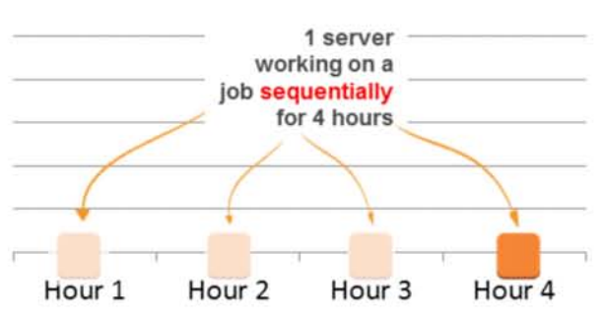
Seven best practices: Think parallel
Experiment with parallel architectures

Slide 20
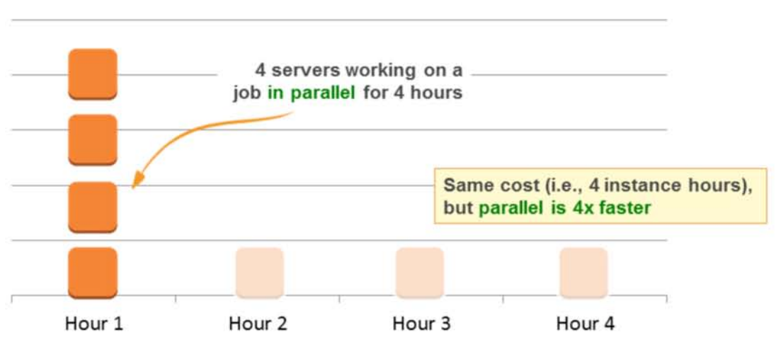
Seven best practices: Think parallel (continue)

Slide 21
Seven best practices: Leverage many storage options
One size does not fit all
Object storage
Content delivery network/edge caching
Block storage
Relational database
NoSQL

Slide 22
Module review
What are the benefits cloud services offer?
List the seven AWS best practices

